Slide 1
DOELAP Assessor Training Online Test
September 2024

Slide 2
Summary
The DOELAP assessor training test will need to be taken online:
The assessors can use the training presentations for the test.
The training presentations will also be available on the RESL website under the DOELAP tab at https://resl.id.energy.gov/doelap/doelap.html

Slide 3
Email Information
The training link and log in instructions should be emailed to each assessor by the end of next week.

Slide 4
Login Screen
The username is the assessor’s email address. Click on “Password Help” to create a password.

Slide 5
Log In Information
You will receive an email from RESL@id.doe.gov with the “Forgot Password” link.

Slide 6
Log In Information (continued)
Create a password within the above guidelines. Click “Reset”. On the next screen, click “Continue”. The log in screen will appear again.

Slide 7
Log In Information (continued)
After you enter your username and password and click “Log in”, another email will be sent with a security code. Enter security code on login screen and click “Submit”.

Slide 8
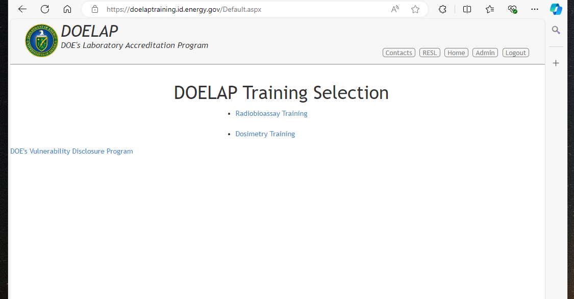
Choose Applicable Training

Slide 9
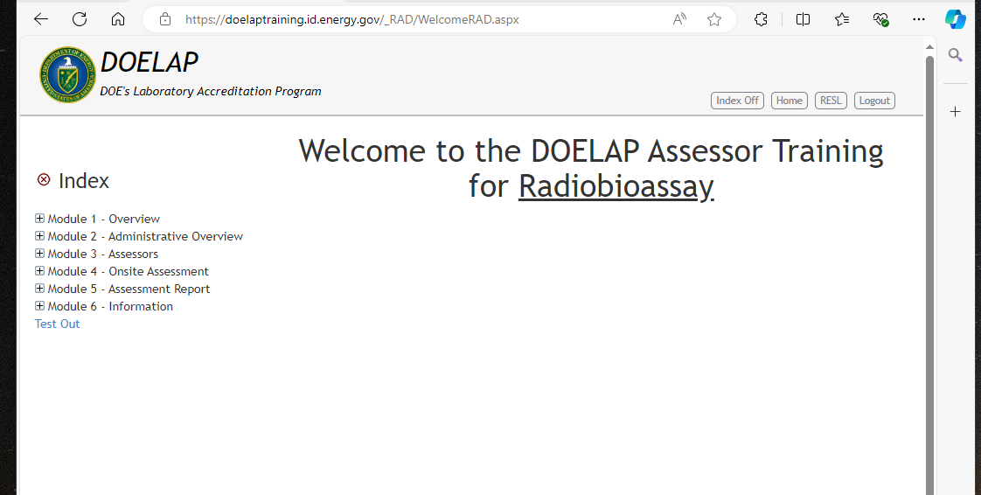
Test Out

Slide 10
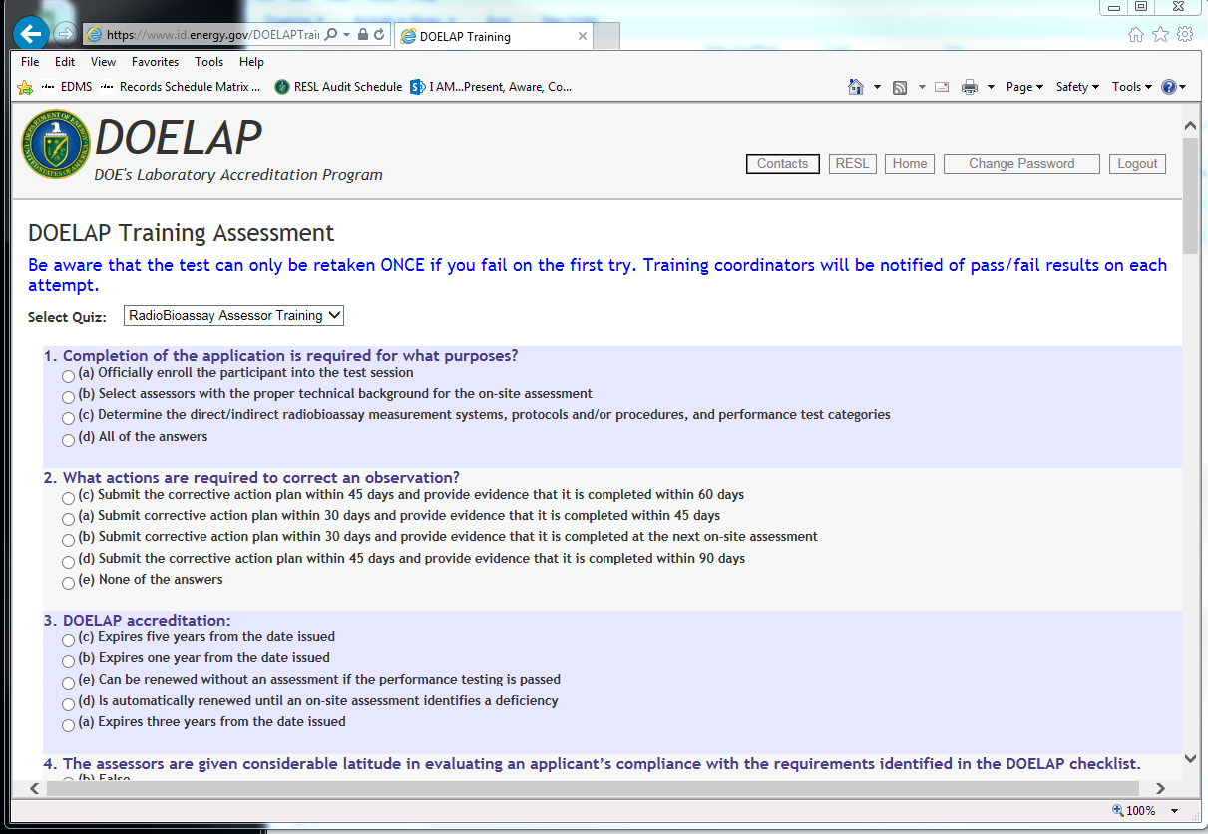
Test Example

Slide 11
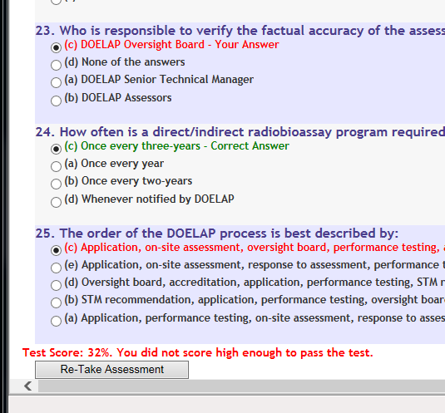
Test Information
After the test is finished, the score will appear on the screen indicated a pass or fail.
Assessors must get at least an 80% on the test to pass.
If an assessor fails the exam, they will only be allowed to retake it once.

Slide 12
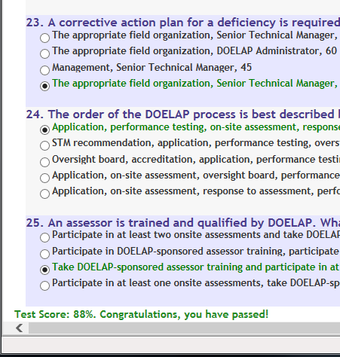
Test Information (continued)
If an assessor fails the exam twice, they will be contacted by the Senior Technical Manager.
After the assessor passes the test, the training completion certificate will be emailed/mailed to them.

Slide 13
Questions?

